Slide 1




FINAL YEAR PROJECT
Presented by :
M. Asmaad Saeed, Laiba Siraj, Fatima Zahid and Areeba Rehman
AI INBOUND CALLING AGENT
Project Review

Slide 2


FYP
01
Project Overview
02
Use-Cases and Real-World Problems
03
Progress Till Now
04
Overall Workflow of the System
05
ASR (Automatic Speech Recognition)
06
NLU (Natural Language Understanding)
07
TTS (Text-to-Speech)
Contents
08
Knowledge Graph and Reasoning
09
Currently Working On
10
Future Work

Slide 3


Project Overview
AI Inbound Calling Agent
Our project focuses on building an AI-powered inbound calling agent that can automatically answer phone calls, understand user queries, and respond in a natural human-like voice. The system is designed to handle high volumes of calls efficiently while providing accurate, context-aware information.
Initially developed for the University of Sargodha (UOS), the system acts as an intelligent virtual receptionist capable of answering admission-related queries and other informational requests without human intervention.
Value Created
Reduces workload on human call center staff
Provides 24/7 availability
Delivers fast, consistent, and accurate responses
Improves user experience through natural voice interaction
Scalable for multiple domains (education, banking, healthcare)

Slide 4

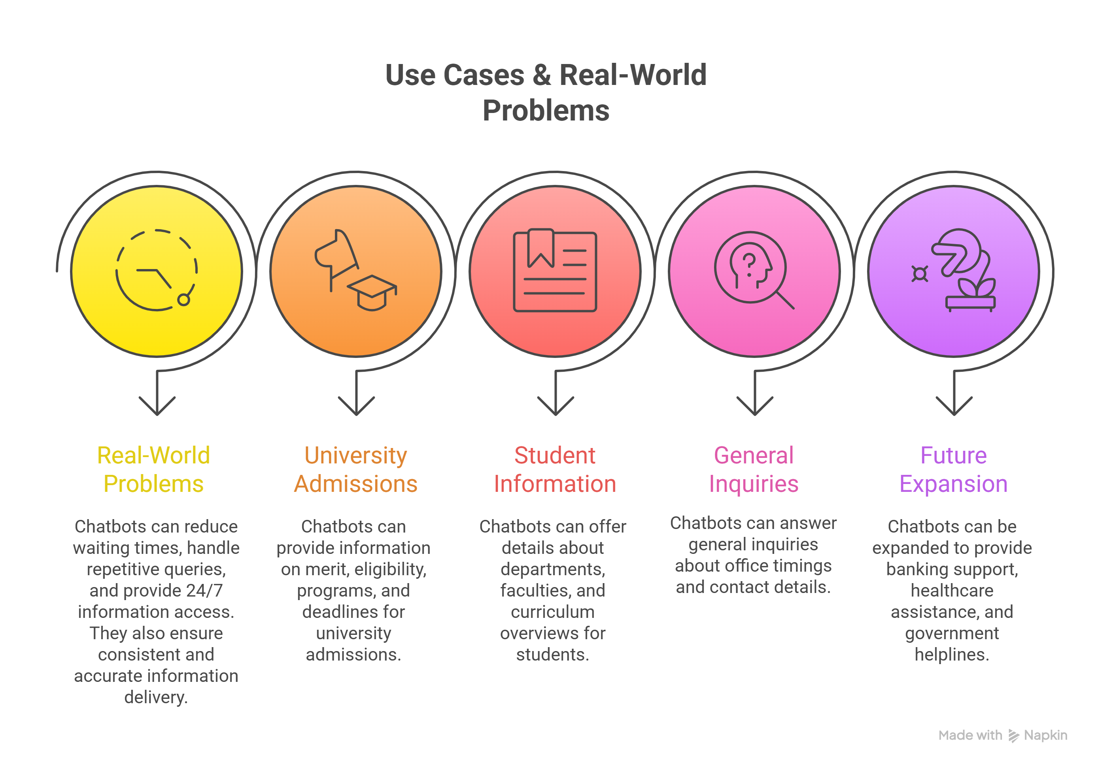

FYP
USE-CASES and Real-World Problems

Slide 5
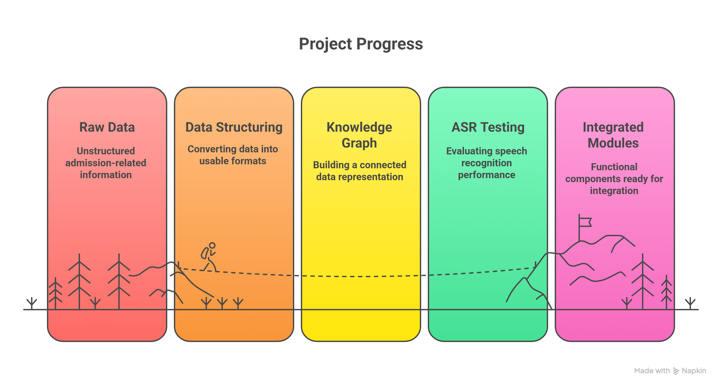
FYP
Progress Till Now

Slide 6
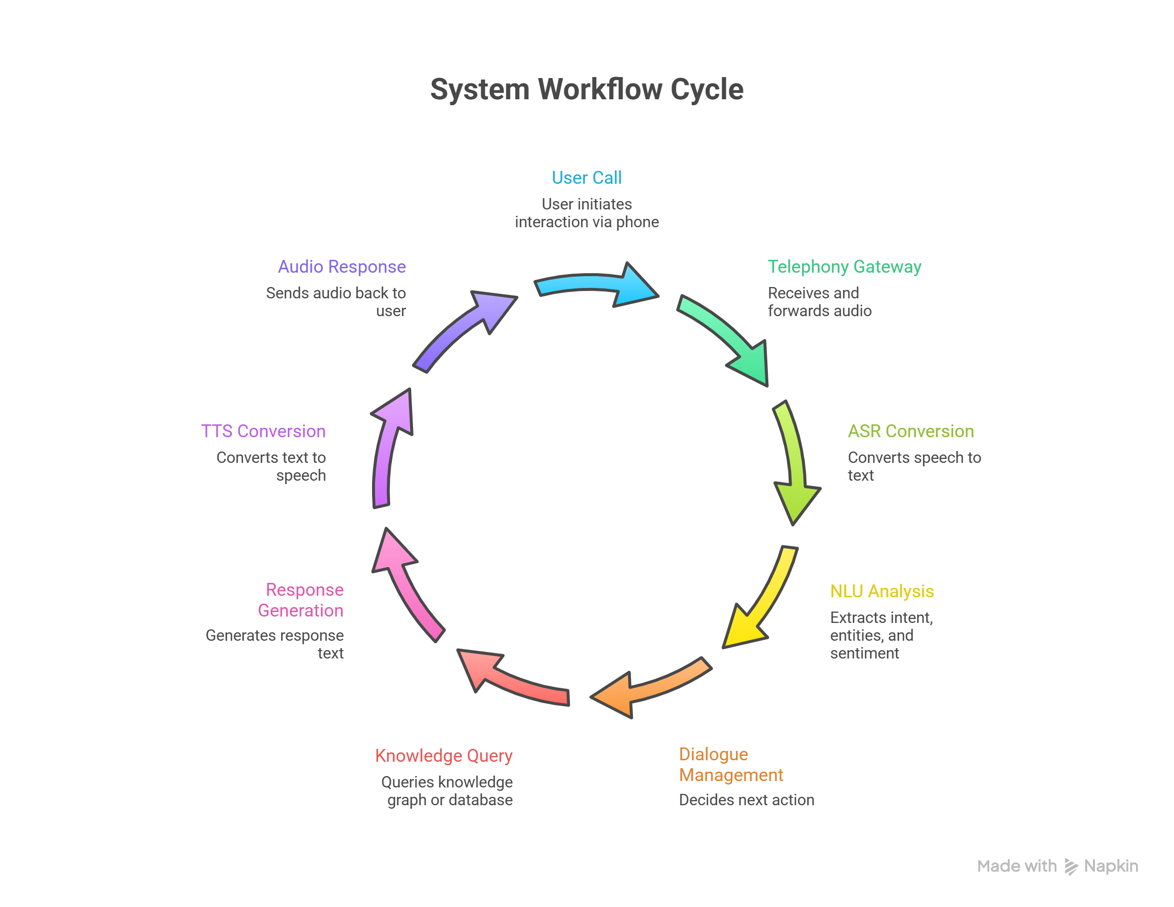

Overall Workflow of the System

Slide 7
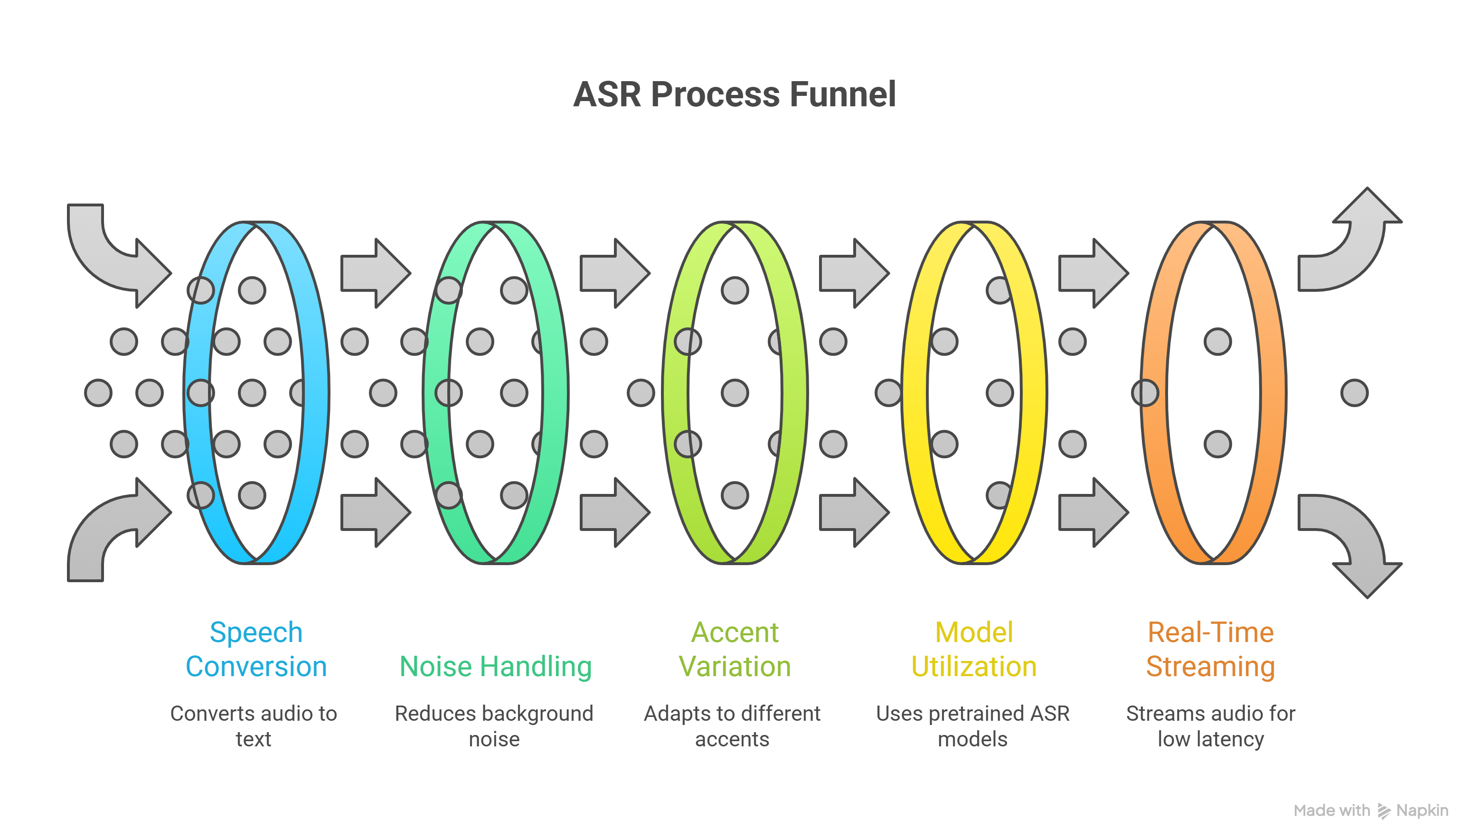
FYP
ASR MODULE

Slide 8
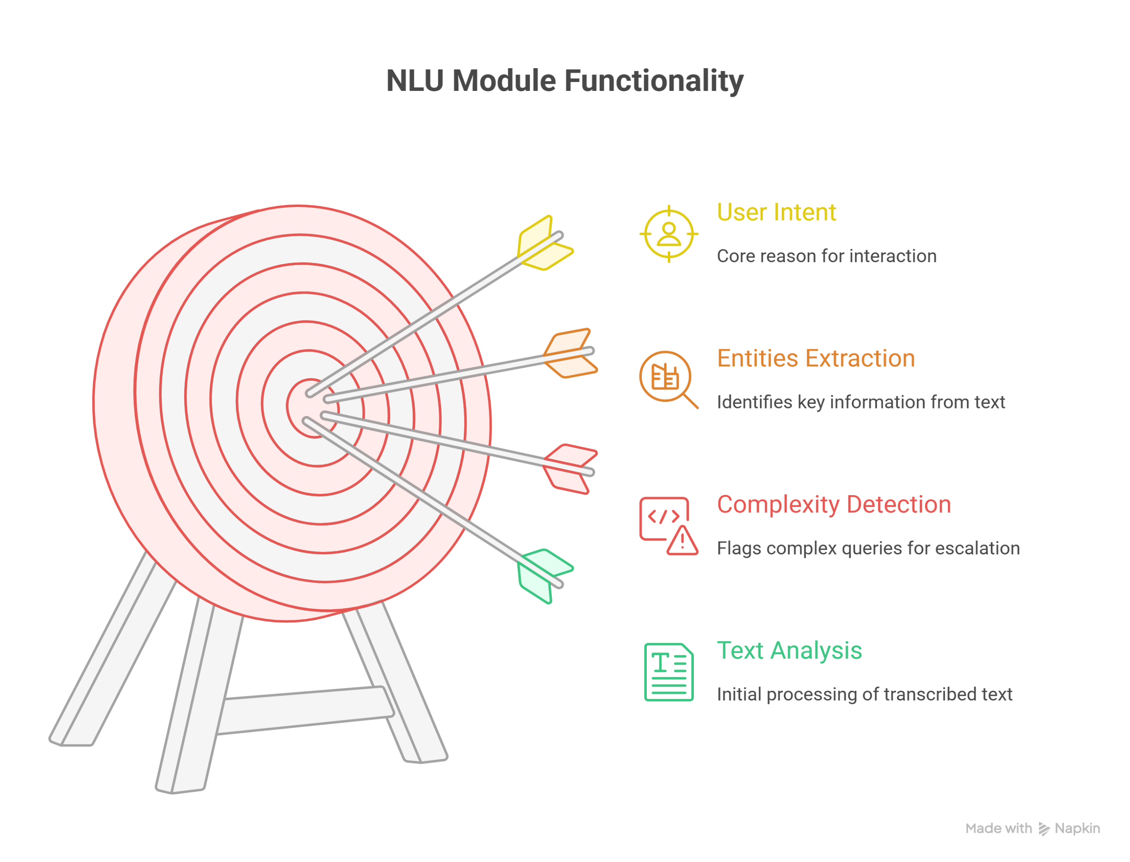
NLU Module

Slide 9
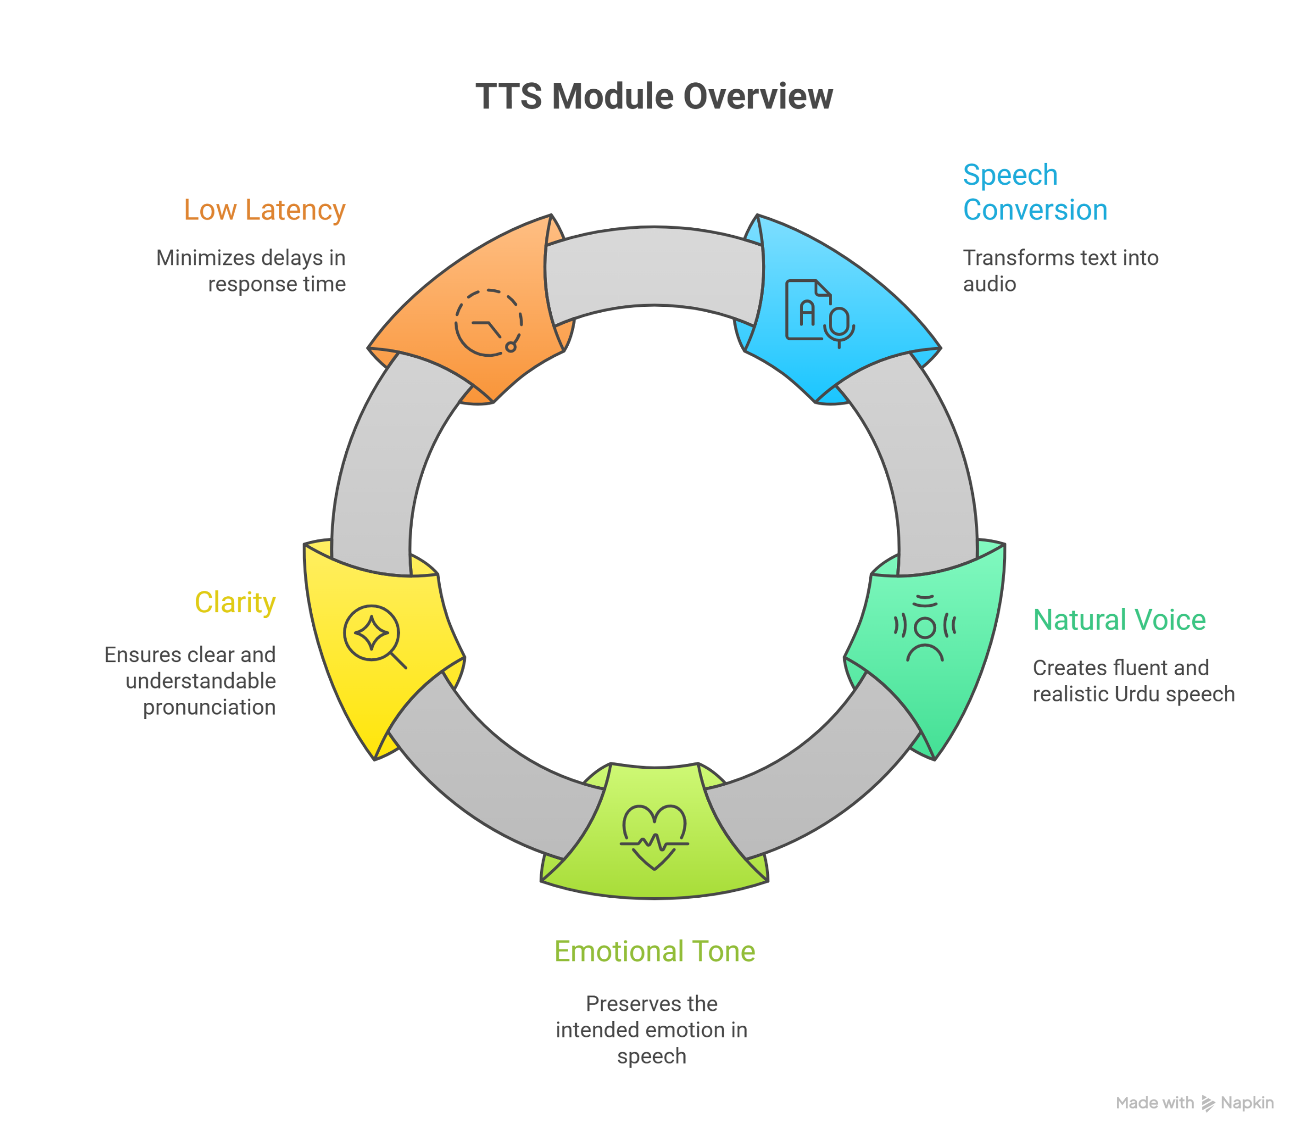
TTS Module

Slide 10
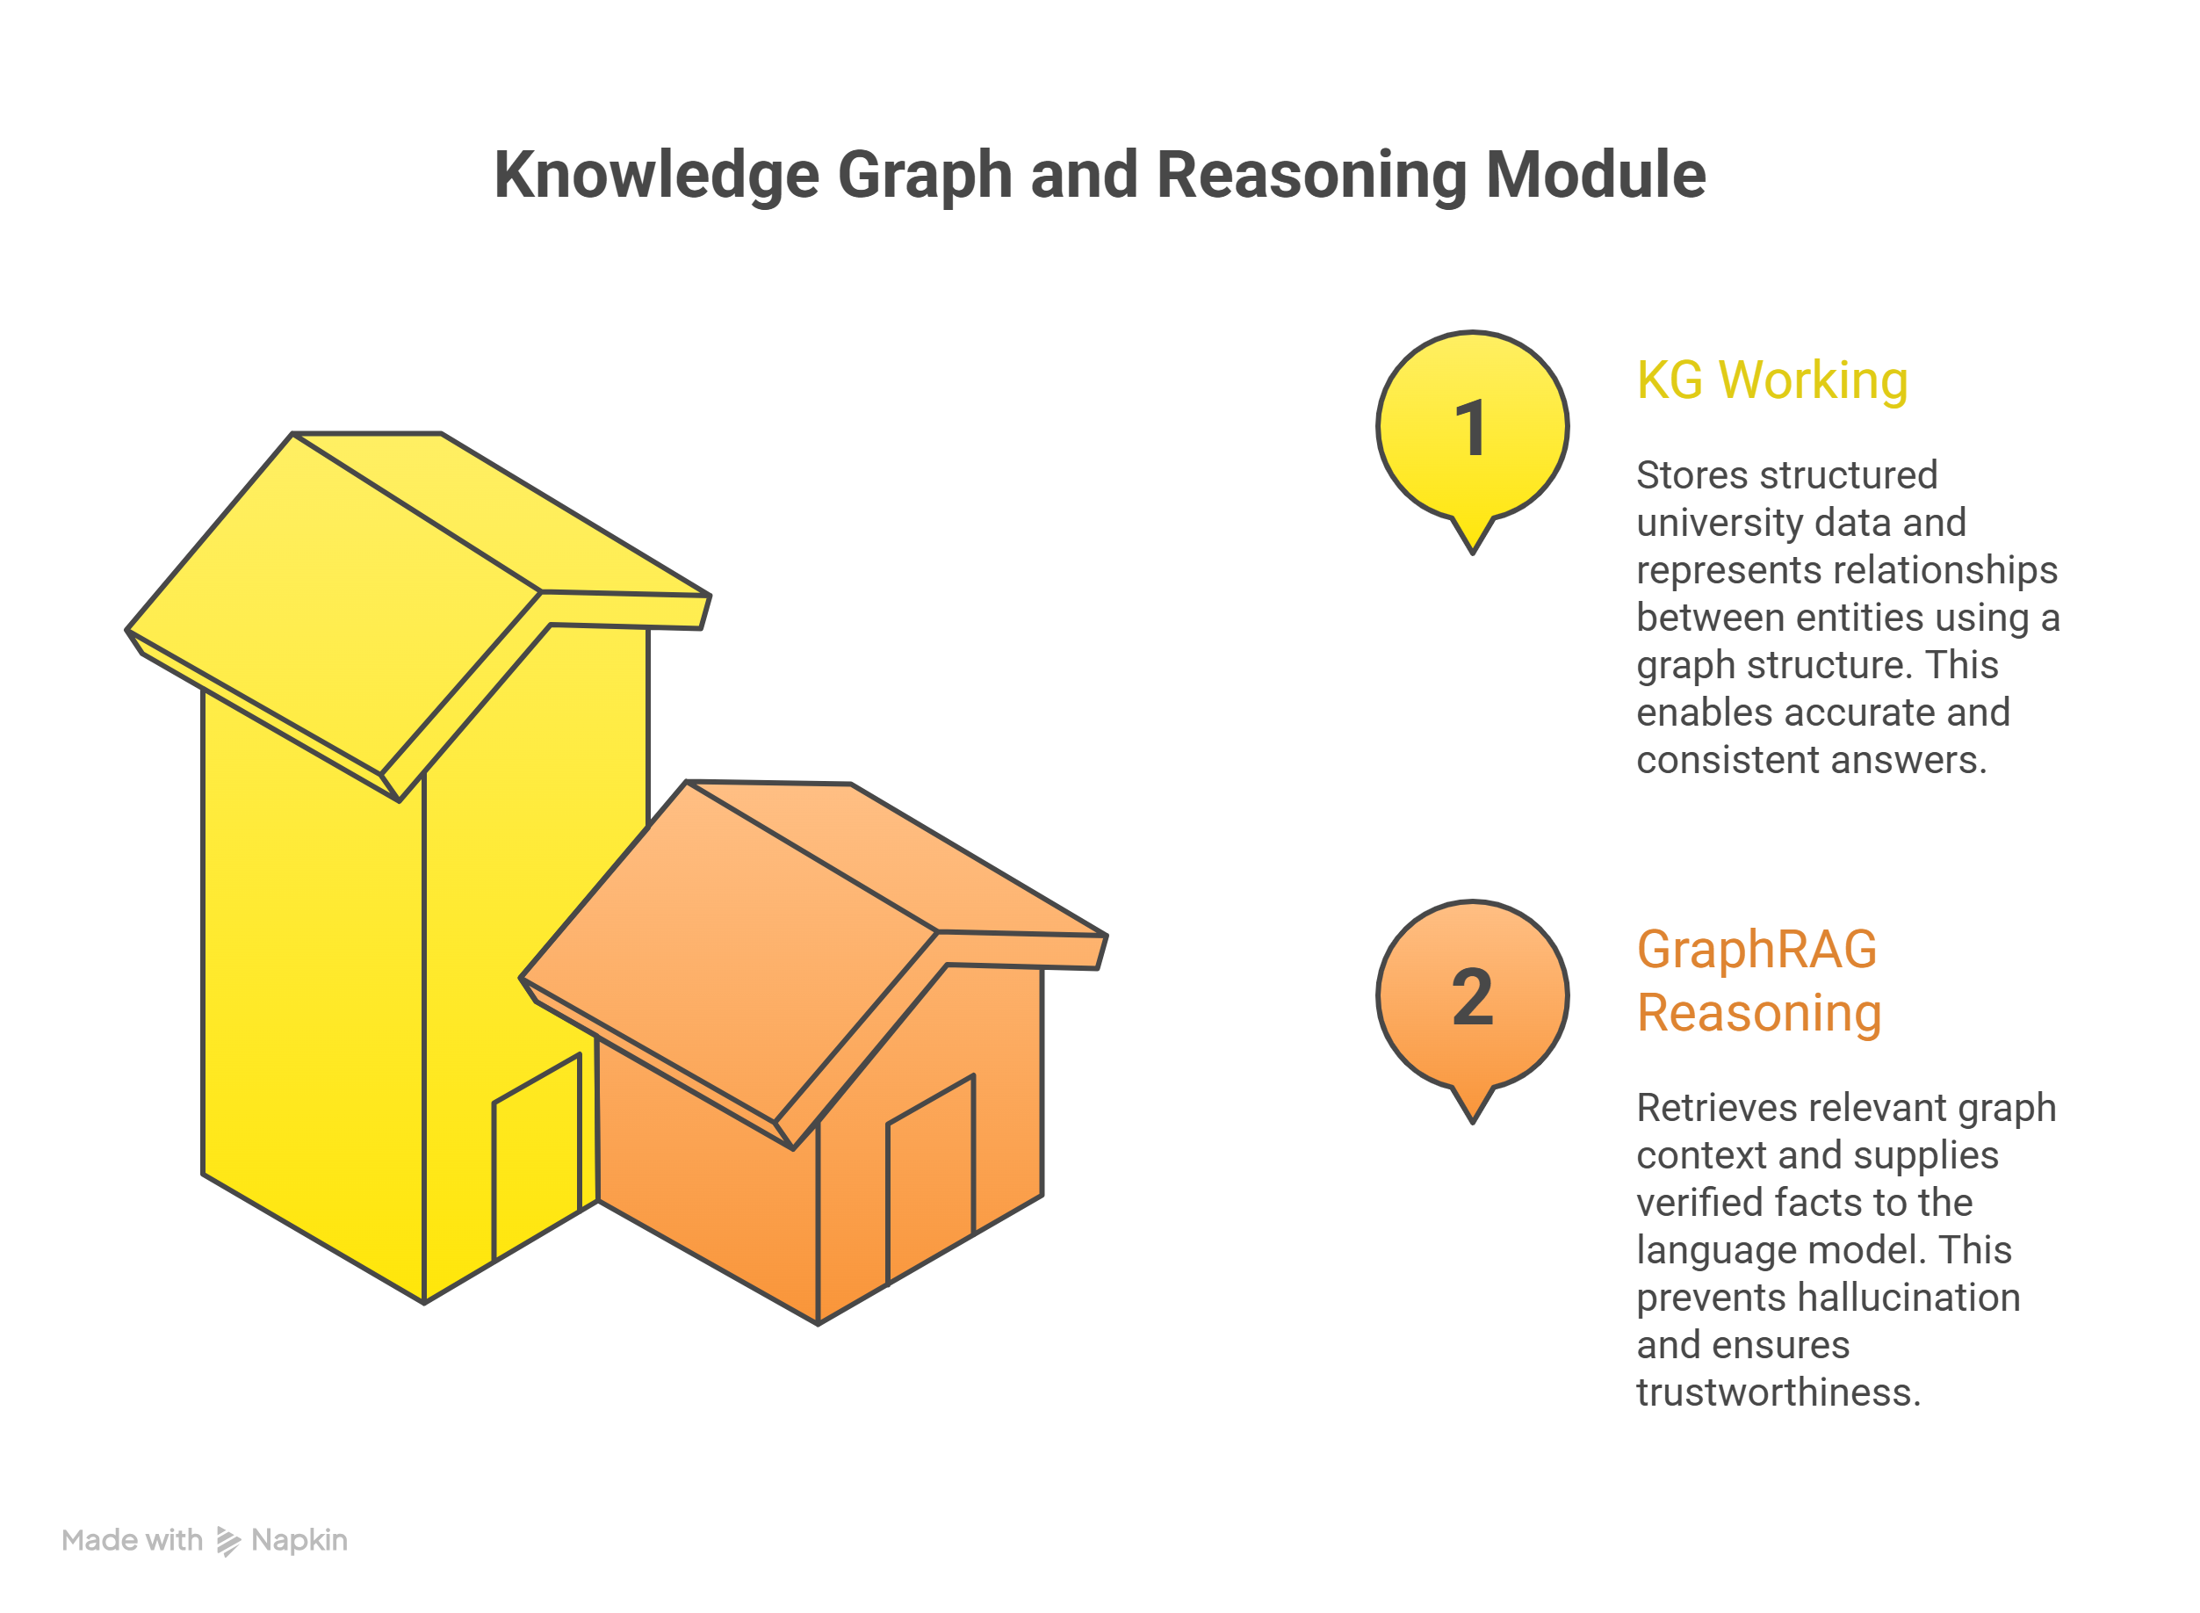
KG and Reasoning Module

Slide 11
Currently Working On
Ongoing Development
Expanding Knowledge Graph using real-world + synthetic data
Refining KG schema and relationships
Integrating ASR, NLU, KG, and TTS modules
Building admin dashboards for data updates
Developing a web application for query testing and monitoring

Slide 12
AI INBOUND CALLING AGENT
Planned Enhancements
Full Deployment with Telephony Gateways
Multi-Language Support ( Regional Languages )
Advanced Emotion Detection
Voice Biometrics for authentication
Expansion to other domains (banking, healthcare)
Continuous learning from call logs and feedback
The Goal is to transform the system into a production-ready conversational AI Platform.

